Slide 1
Improving vr immersion by understanding dreams
Aurora J. Miller, Researcher

Slide 2
ORIGIN
Heuristic evaluation has suggested that VR space feels very similar to dream space. Is it possible that our brains process input the same way in both situations, and in fact can’t tell them apart?
If so, given that we can design and control VR experiences in ways that are not (yet) available in dreams, how can we make more compelling and effective VR experiences?

Slide 3
OBJECTIVES
Determine whether there is evidence to support the hypothesis that our
optical nerves and neurons can’t tell the difference between VR and dreams.
Determine whether content creators can leverage the extant
understanding of symbols and imagery that our brains associate with dreams
to create more compelling and emotionally evocative VR experiences.

Slide 4
methodology
Review the available research on how our brains process both VR and dreams.
Review anecdotal reports on users’ experiences of VR and dreams.
Identify key universal symbols associated with dreams, that could be utilized in VR.

Slide 5
Summary of findings
There appear to be correlations between dream experiences and “virtual” experiences, but there is insufficient research to date to be truly conclusive.
Anecdotal evidence indicates that individuals who use VR technology for an extended period of time are likely to have more vivid dreams, and to remember them more consistently.
Regardless of the neurological implications, the incorporation of universally recognized symbols in VR experiences is likely to result in more effective and compelling content.

Slide 6
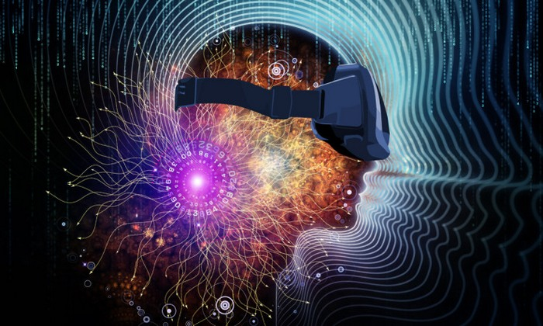
VR VERSUS DREAMS
There appears to be consensus that there is a relationship between VR and dreams… But precisely what that connection is has yet to be identified.
“…we finally have a tool that reliably manipulates nightly dream content and that tool will revolutionize dream research.”
- Patrick McNamara Ph.D.

Slide 7
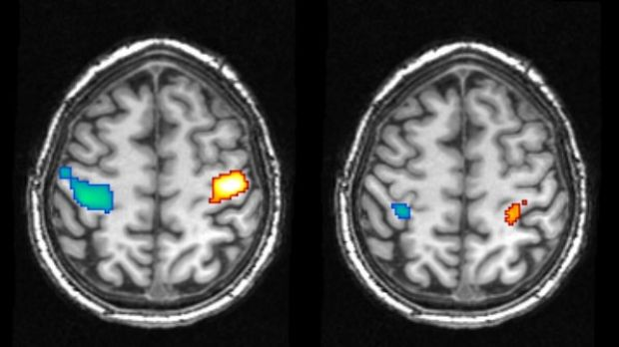
VR versus dreams
McNamara, a neuropsychologist at Boston University, has been quoted as suggesting that brain activity during VR is very similar to that experienced while dreaming.
“By using a virtual-reality device, you are putting yourself into a brain state that is remarkably like the REM brain state: a simulation without correction by external input. So it’s easy to recall similar brain states or simulations under those conditions.” - Patrick McNamara Ph.D.
Brain scans showing activity in the motor cortex during the movement of the hands while awake (left) and during a dreamed movement (right).
Photo: Martin Dresler

Slide 8
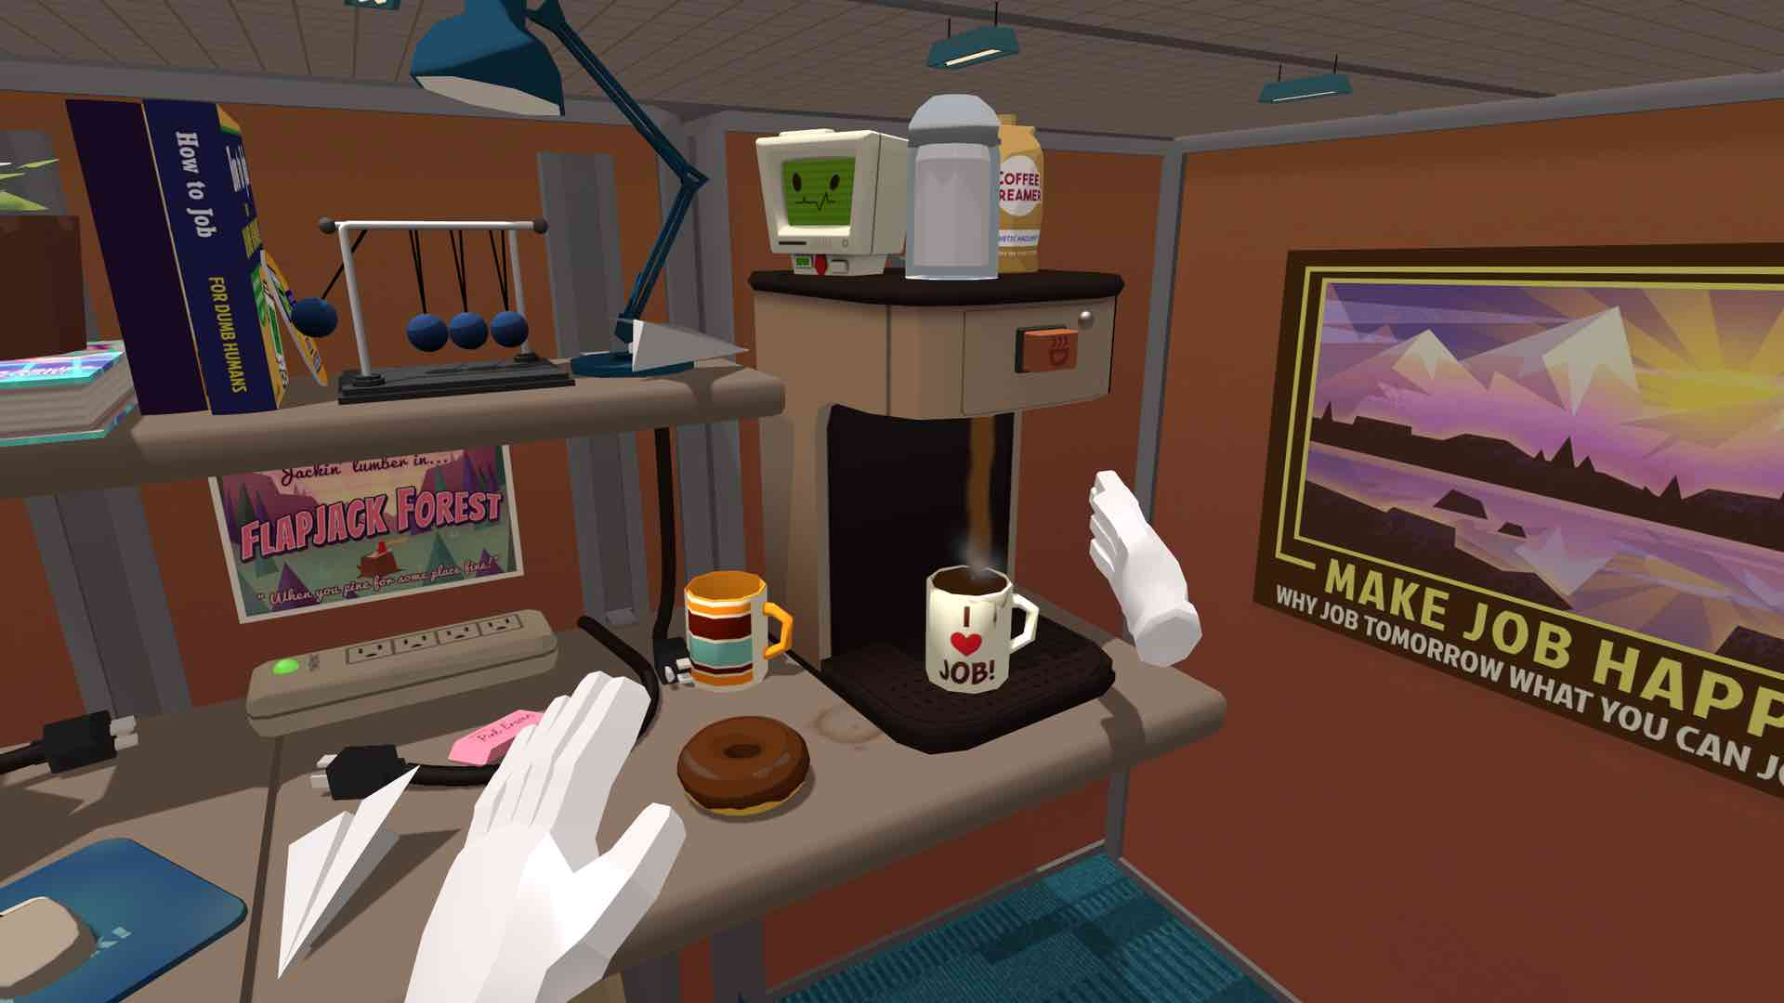
Vr versus dreams
One possible reason for the similarity is that due to computational limitations, the modeling in VR is often limited in complexity, and as such echoes dreams, in which we are only aware of the relevant details.
“…dreaming plays an essential role in maintaining and enhancing the capacity to model the world by minimizing model complexity and thereby maximizing both statistical and thermodynamic efficiency.”
- J. Allan Hobson, Charles C.-H. Hong, and Karl J. Friston
VR experience “Job Simulator”

Slide 9
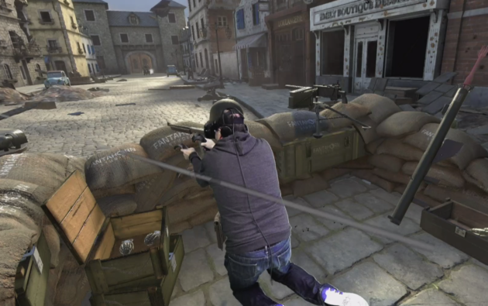
VR VERSUS DREAMS
“In two different games, I tried to place my arm on a virtual wall to brace myself, forgetting for an instant that it wasn’t actually there.” - Todd Bishop, GeekWire
Another reason may be our relative awareness of larger context; if the VR experience is sufficiently immersive, our brains may ‘forget’ that the fictional world is not the ‘real’ world.
“Our dreaming consciousness consists of a single “track”: we are not contextually aware of where we are (in bed) or of what we are doing (sleeping, dreaming). There is a strong tendency for a distinct narrative of thoughts and images to persist without disruption (“single-mindedness”).” - Yuval Nir and Giulio Tononi

Slide 10
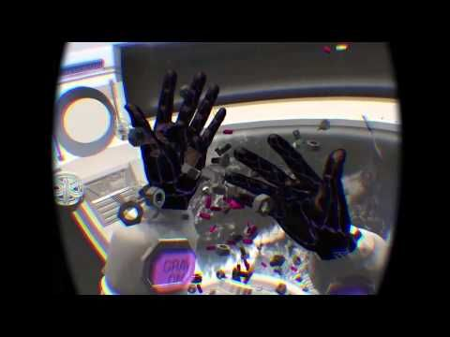
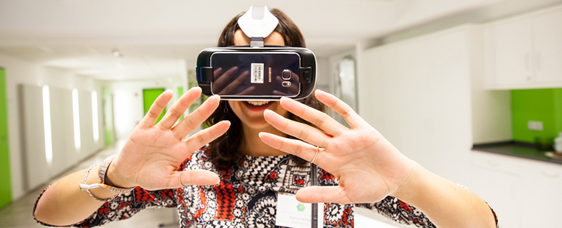
Vr versus dreams
To establish the larger context, in dreams or in VR, a common tendency is to look at one’s hands, often the only anchor to the “real” reality.
“…technique of looking at his hands while dreaming to induce and stabilize lucid dreams…the dreamer's body provides one of the most unchanging elements in the dream, which can help to stabilize the dreamer's otherwise feeble identity in the face of a rapidly changing dream.”
– Dr. Stephen LaBerge

Slide 11
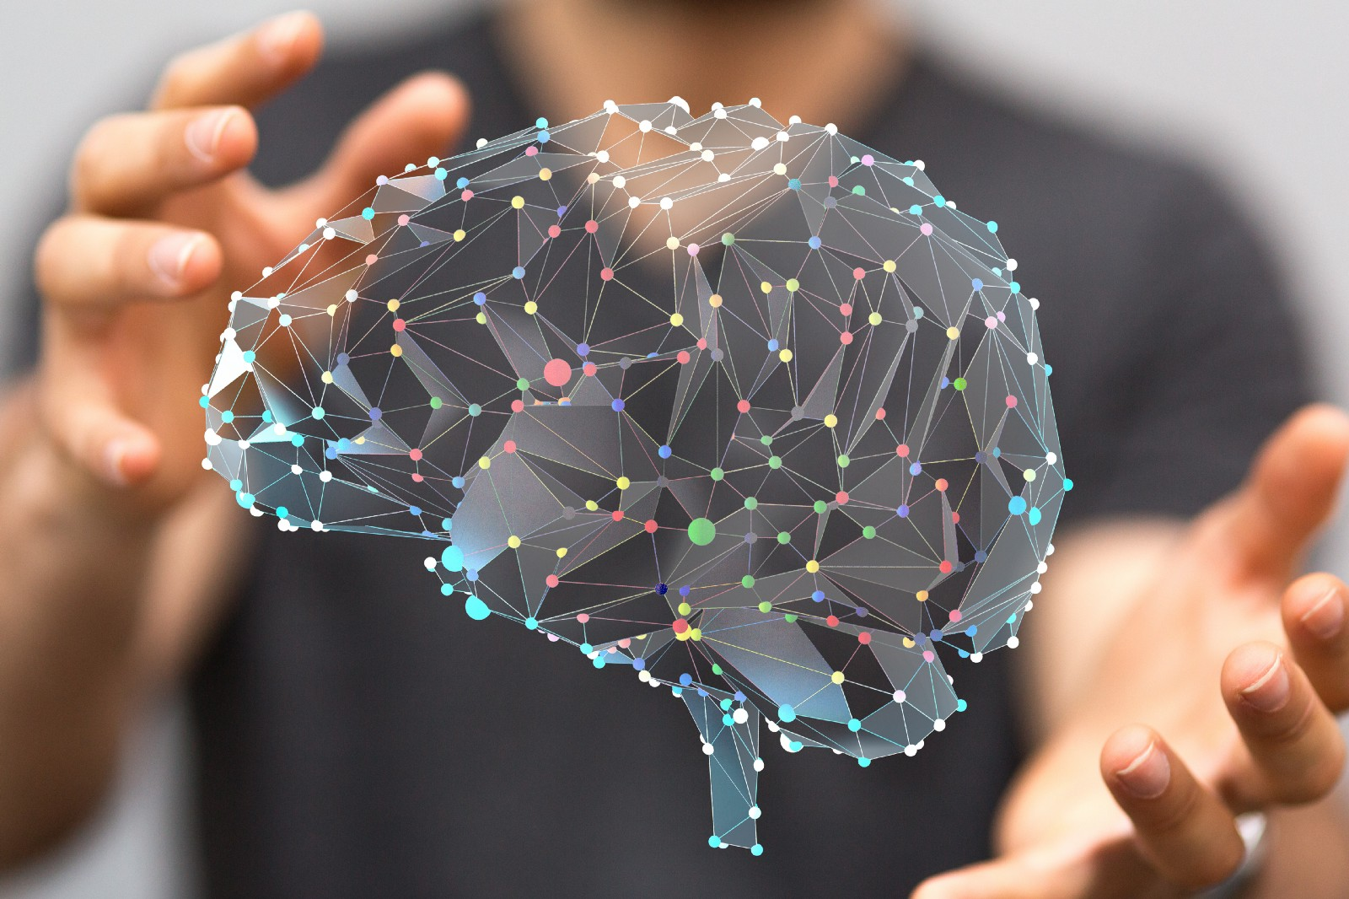
VR Versus dreams
However some researchers have suggested that it’s all moot, because the brain can’t tell the difference between “real”, “dreamed”, and “imagined”; much less “virtual”.
“…from the brain’s point of view it doesn’t know the difference between dreaming and consciously thinking –
it’s all a brain process.”
- Hacker-turned-neuroscientist
Moran Cerf
“In a sense, all reality is virtual; it is constructed through our cognition and sensory organs. Reality is not so much ‘out there’, rather it is what we pragmatically consider to be ‘out there’.”
- Koert van Mensvoort

Slide 12
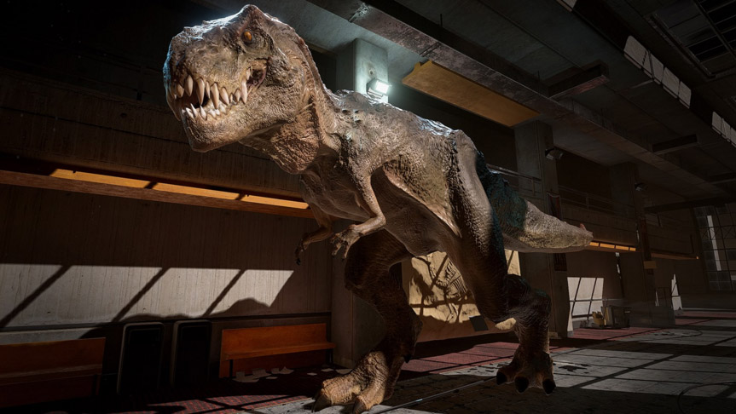
VR versus dreams
The research completed by Jayne Gackenbach of MacEwan University affirms that “gamers report a greater sense of control in their dreams than non-gamers, as well as more awareness that they are dreaming…” going so far as to say, “Your brain’s kind of stupid, at least when it comes to reality.”
Even though we know it’s fictional and that we’re completely safe, a number of users have felt their pulse rise when confronted with the T-Rex in Oculus Dreamdeck.

Slide 13
Vr versus dreams
Ultimately, VR experiences aren’t held captive to the laws of physics or biology any more than dreams are.
We, as content creators and as users, are limited only by our imagination (and in some cases, our ability to withstand motion sickness).
As such, it could be argued that we have a duty to push the boundaries of our assumptions, to create unexpected and meaningful content.
“Dreams tell me that my physical body is not hard-coded into my brain…
VR, on the other hand, doesn’t require self-awareness in order to work.”
- Vi Hart, mathematician and VR developer

Slide 14
“I wonder if it is possible if you are teaching your unconscious mind how to better 3D render…”
- anima173, reddit user

Slide 15
Anecdotes: dreams & vr
“Sometimes when people ask me about specific experiences I've had in VR I almost have a hard time conveying it, I think this is because it's almost like trying to remember a dream.” - MightyMouse420, reddit user
“Since I started using my HTC Vive…I’m actually remembering almost every dream I have.” - Bradllez, reddit user
“I've found that control of my hands seems more like I'm in VR than in a dream.” - izzyfoshizzy, reddit user
A number of threads have popped up on reddit, in which users compare and contrast their dream experiences post-VR.

Slide 16
Anecdotes: dreams & vr
“…one of the ways I've realized I was in a dream was through my expectation of haptics. While dreaming, I asked myself the question "am I in VR right now". I then felt around in the world and noticed I had absolutely no sense of tactile feedback. That made me realize I must be dreaming because in legit VR or "reality", I should at least be feeling some vibration or physical sensation.”
- jonnydpakable, reddit user

Slide 17
Making immersive vr
“From that felt sense of presence when playing a game comes emotional investment to the experiences within that game. And from that emotional investment comes deeper and deeper immersion. In fact, emotional investment holds such a strong grip over how much ‘presence’ can be felt while using the [Oculus] Rift that many participants noted its immediate decline in direct relation to any glitch or technological shortcoming that might arise.” – Jayne Gackenbach, et.al.
If the goal is to create the most immersive VR experience possible, what are the benchmarks?
Gackenbach’s team suggests that increased emotional investment is the key.

Slide 18
Making immersive vr
The most successful films and other visual media have used symbolism to subtly convey meaning and to increase emotional intensity.
It stands to reason that successful VR applications will do likewise; particularly if, as the above research findings suggest, our brains expect VR to act like a dream, and to use similar symbols and imagery.

Slide 19
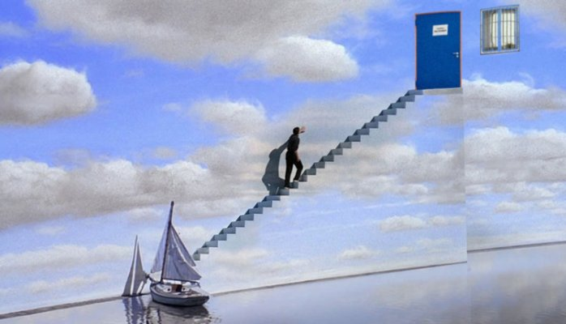
Symbolism in movies
In The Truman Show, Peter Weir uses stairs to imply that Truman is ascending to a new level of understanding about himself, and a doorway that represents crossing into the unknown.

Slide 20
Symbolism in movies
The owl in Jim Henson’s Labyrinth represents wisdom—
which in this case is often just out of reach.
The pools of water in this scene are also meaningful, signifying depth of emotion.

Slide 21
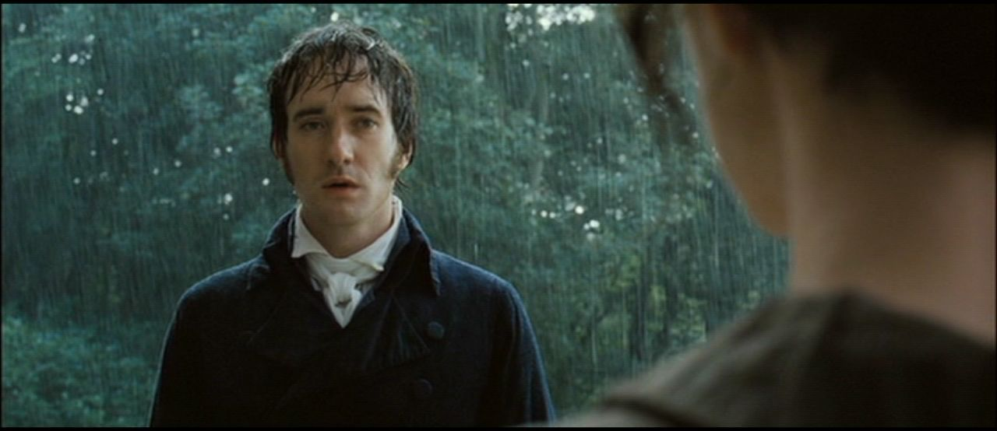
Symbolism in movies
Another example of the evocative use of water is in Joe Wright’s version of Pride & Prejudice, where the pouring rain echoes the lovers’ tumultuous emotions finally breaking free and pouring out of them.

Slide 22
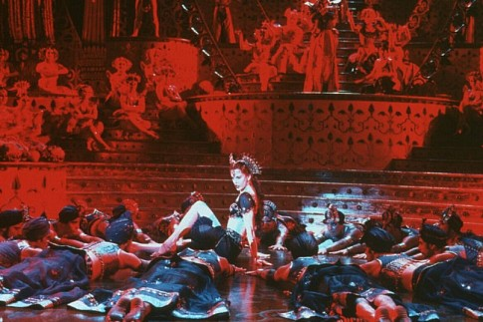
Symbolism in movies
In Baz Luhrman’s Moulin Rouge, deeply saturated red is used throughout the club to signify the brooding passion found within.

Slide 23
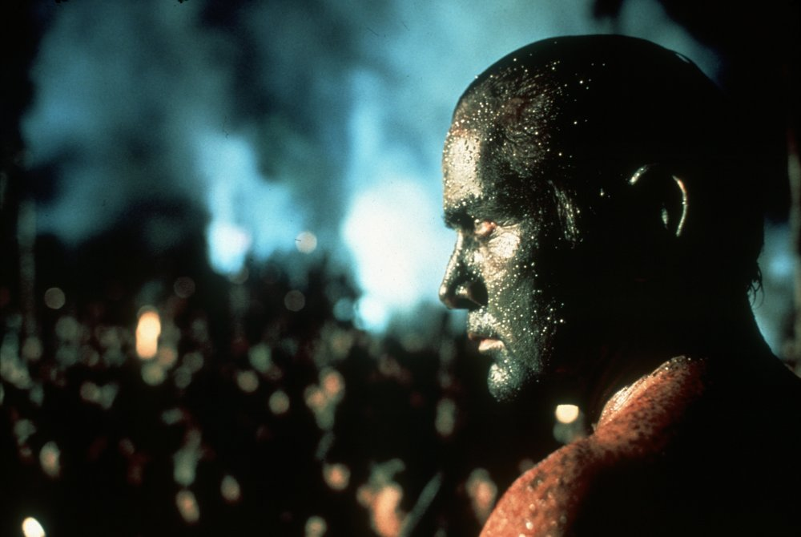
Symbolism in movies
Francis Ford Coppola’s Apocalypse Now shows many characters in masks or face paint, conveying to the audience that each character has assumed a new identity that enables them to carry out the atrocities expected of them.

Slide 24
Symbolism in movies
Mirrors are also often used to convey details of a character’s self-perception.
In Darren Aronofsky’s Black Swan, Nina is constantly surrounded by mirrors that fuel her obsession and paranoia; the final broken mirror echoes the fractures in her psyche.

Slide 25
Symbolism in movies
But of course not all symbolism is dark. The seedling cherished by the robots in Disney/Pixar’s WALL-E stands for hope, and the promise of new life.

Slide 26
Symbolism in vr
When first activating the VR experience Flow, the white eye shapes peering out of pure darkness are pretty off-putting.
Having a flashlight that only accentuates the dark forms surrounding those eyes creates an even more ominous sense of foreboding.

Slide 27
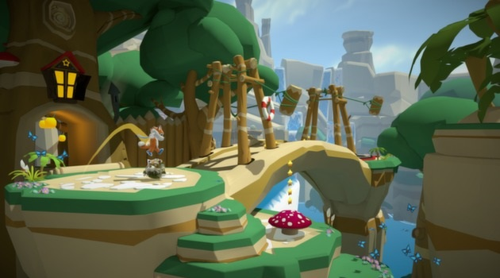
Symbolism in vr
The mountains in Lucky’s Tale are used to provide pragmatic obstacles to progression—but could offer a challenge rising up in the distance…

Slide 28
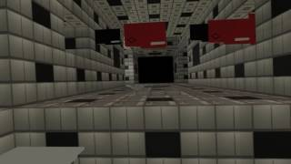
Symbolism in vr
Being chased by file folders in The Cubicle stirs up horrible bureaucratic nightmares, and could hearken a new wave of symbolic meaning for the 21st century.

Slide 29
recap
With only a scant handful of researchers, the evidence cannot be conclusive. However there are definite indicators of a strong relationship between VR and dreams.
There is a wide variety of anecdotes available that suggest that VR usage increases both awareness of and intensity of dreams.
Thoughtful incorporation of universal symbols are likely to increase the effectiveness of VR applications.

Slide 30
Suggested next steps
Complete additional peer-reviewed research that could provide confirmation as to the relationship between VR experiences and dreams.
Continue to collect anecdotal reports from VR users regarding their experiences in and out of VR, particularly with regard to their dreams.
Develop VR applications that incorporate symbolism, and complete UX assessment as to their relative efficacy in contrast with applications that don’t use symbolism.

Slide 31
appendix
Symbols*Images*Codes by Pamela Jaye Smith
https://www.reddit.com/r/Vive/comments/49ull2/vrs_effect_on_dream_comprehension/
https://www.reddit.com/r/Dreams/comments/533tsp/virtual_reality_encourages_gamers_to_have_lucid/
https://www.reddit.com/r/Vive/comments/4zdvxl/virtual_reality_changed_my_dreams/
http://elevr.com/lucid-dreams-the-original-virtual-reality/
https://www.ncbi.nlm.nih.gov/pmc/articles/PMC4191565/
https://www.secretenergy.com/news/the-50-most-common-dream-symbols-and-their-hidden-meanings/
https://www.psychologytoday.com/blog/dream-catcher/201701/virtual-reality-and-dream-research
https://www.theatlantic.com/science/archive/2016/09/virtual-reality-may-help-you-control-your-dreams/500156/
https://therivardreport.com/neuroscientist-will-hack-your-dreams-at-pearl-stable/
https://www.nextnature.net/2009/04/a-society-of-simulations/
http://sites.macewan.ca/macewantoday/files/2016/05/16-05-DreamTimeMagazine-RiftInReality.pdf
https://www.ncbi.nlm.nih.gov/pmc/articles/PMC2814941/

